Slide 1




Presented By
Leader:-Sujan Tharki
Anuraj Anda Wala
Prakash Bhujel
Rondi Chudel
Krish Chamatkar
Sheikh Al-Habibi
Pamas Kanlang Kunlung
Abhi Abbi Shekh

Slide 2
Object Diagram
01
02
03
04
Introduction to
Object Diagram
How to Draw
Object Diagram
Example Of
Object Diagram
What is UML
Object Diagram
05
06
07
08
Application Of
Object Diagram
Where to Use
Object Diagram
Object Diagram
At Glance
Object Diagram
At a Glance Example
09
10
11
12
Object Diagram VS
Class Diagram
Purpose Of
Object Diagram
Modeling Object
Structure
Conclusion

Slide 3
Introduction to Object Diagram
An object diagram is a structural diagram used in software development and system modeling to visualize the static structure of a system at a particular point in time. It belongs to the Unified Modeling Language (UML) and provides a detailed representation of the objects and their relationships within a system or a specific scenario. Object diagrams are useful for understanding how objects interact and collaborate to accomplish specific tasks within the system.
In an object diagram, objects are represented as individual instances of classes, and their attributes and relationships are shown with specific values. These diagrams are particularly useful for visualizing and understanding how objects collaborate and interact with each other within a system or a specific use case.

Slide 4
What is UML Object Diagram
UML, which stands for (Unified Modeling Language), is a way to visually represent the architecture, design, and implementation of complex software systems. When you’re writing code, there are thousands of lines in an application, and it’s difficult to keep track of the relationships and hierarchies within a software system. UML diagrams divide that software system into components and subcomponents.
Why Should you Use UML Diagrams?
UML is a standardized modeling language that can be used across different programming languages and development processes, so the majority of software developers will understand it and be able to apply it to their work.
Bring new team members or developers switching teams up to speed quickly
Navigate source code.
Plan out new features before any programming takes place.
Communicate with technical and non-technical audiences more easily.

Slide 5
UML Diagram
Types
Two Types Of UML Diagram
Structural Diagram
A structure diagram is a conceptual modeling tool used to document the different structures that make up a system such as a database or an application. It shows the hierarchy or structure of the different components or modules of the system and shows how they connect and interact with each other. It is a tool used to guide developers to ensure that all parts of the system work as intended in relation to all the other parts.
Behavior Diagram
Behavioral diagrams portray a dynamic view of a system or the behavior of a system, which describes the functioning of the system. It includes use case diagrams, state diagrams, and activity diagrams. It defines the interaction within the system.

Slide 6
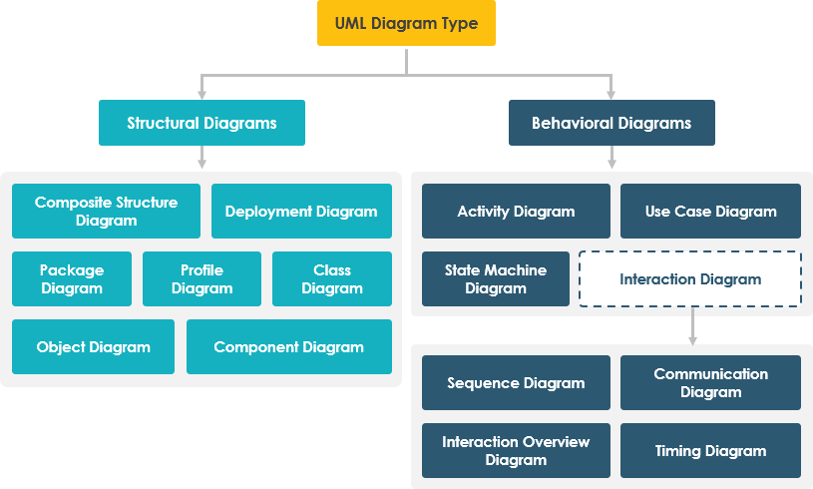
UML Diagram

Slide 7
How to Draw
Object Diagram
We have already discussed that an object diagram is an instance of a class diagram. It implies that an object diagram consists of instances of things used in a class diagram.
So both diagrams are made of same basic elements but in different form. In class diagram elements are in abstract form to represent the blue print and in object diagram the elements are in concrete form to represent the real world object.
To capture a particular system, numbers of class diagrams are limited. However, if we consider object diagrams then we can have unlimited number of instances, which are unique in nature. Only those instances are considered, which have an impact on the system.

Slide 8
Example of
Object Diagram
Husband
wife
Ronak
Age:-30
Marriage
Ronkey
Age:-32
Child
Child
Child
Roman
Age:-10
Rojita
Age:-13
Raja
Age:-15

Slide 9
Step of Creating
Object Diagram
Below are the steps to draw Object Diagram in UML:
Step 1)
Before drawing an object diagram, one should analyze all the objects inside the system.
Step 2)
The relations of the object must be known before creating the diagram.
Step 3)
Association between various objects must be cleared before.
Step 4)
An object should have a meaningful name that describes its functionality.
Step 5)
An object must be explored to analyze various functionalities of it.

Slide 10
Object Diagram Symbol and Notations
Object Names:
Every object is actually symbolized like a rectangle, that offers the name from the object and its class underlined as well as divided with a colon.
Object: Class
Object Attributes:
Similar to classes, you are able to list object attributes inside a separate compartment. However, unlike classes, object attributes should have values assigned for them.
Object: Class
Attribute = value
Links:
Links tend to be instances associated with associations. You can draw a link while using the lines utilized in class diagrams.

Slide 11

Videos Clip How to Draw Object Diagram

Slide 12
Steps for Modeling Object Structures.
A communication diagram (called collaboration in previous version of UML) without messages is also known as an object diagram, and the relationships between objects are called links. An object diagram must be a valid instantiation of a static class diagram. Objects must have classes and links between objects must be instances of associations between classes. This can be used as a quick consistency check. To do this we can develop an object diagram by using the following steps:
Identify the mechanism you'd like to model. A mechanism represents some functions or behaviors of the part of the system you are modeling that results from the interaction of a society of classes, interfaces, and other things.
For each mechanism, identify the classes, interfaces, and other elements that participate in this collaboration; identify the relationships among these things, as well.
Consider one scenario that walks through this mechanism. Freeze that scenario at a moment in time, and render each object that participates in the mechanism.
Expose the state and attribute values of each such object, as necessary, to understand the scenario.

Slide 13
Application of
Object Diagram
Following are the applications of Object Diagram:
Object diagrams play an essential role while generating a blueprint of an object-oriented system.
Object diagrams provide means of modeling the classes, data and other information as a set or a single unit.
It is used for analyzing the online or offline system. The functioning of a system can be visualized using object diagrams.
To build a prototype of a system.
To model complex data structures.
To perceive the system from a practical perspective.
Reverse engineering.

Slide 14
Where to use of
Object Diagram
Object diagrams can be imagined as the snapshot of a running system at a particular moment. Let us consider an example of a running train
Now, if you take a snap of the running train then you will find a static picture of it having the following −
A particular state which is running.
A particular number of passengers. which will change if the snap is taken in a different time
Here, we can imagine the snap of the running train is an object having the above values. And this is true for any real-life simple or complex system.
In a nutshell, it can be said that object diagrams are used for −
Making the prototype of a system.
Reverse engineering.
Modeling complex data structures.
Understanding the system from practical perspective.

Slide 15
Object Diagram
At a Glance
An object diagram shows this relation between the instantiated classes and the defined class, and the relation between these objects in the system. They are be useful to explain smaller portions of your system, when your system class diagram is very complex, and also sometimes modeling recursive relationship in diagram.
The best way to illustrate what an object diagram look like is to show the object diagram derived from the corresponding class diagram.
The following Order Management System shows their relationships. This small class diagram shows that a university Department can contain lots of other Departments and the object diagram below instantiates the class diagram, replacing it by a concrete example.

Slide 16
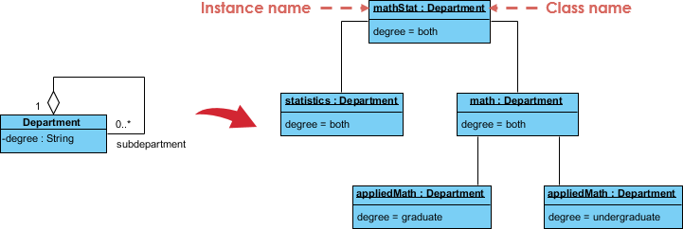
Example of Object Diagram
At a Glance

Slide 17
Purpose Of Object Diagram
The purpose of a diagram should be understood clearly to implement it practically. The purposes of object diagrams are similar to class diagrams.
The difference is that a class diagram represents an abstract model consisting of classes and their relationships. However, an object diagram represents an instance at a particular moment, which is concrete in nature.
It means the object diagram is closer to the actual system behavior. The purpose is to capture the static view of a system at a particular moment.
The purpose of the object diagram can be summarized as −
Forward and reverse engineering.
Object relationships of a system
Static view of an interaction.
Understand object behavior and their relationship from practical perspective

Slide 18
Class VS Object Diagram
No. | Class Diagram | Object Diagram
1 | It depicts the static view of a system. | It portrays the real-time behavior of a system.
2 | Dynamic changes are not included in the class diagram. | Dynamic changes are captured in the object diagram.
3 | The data values and attributes of an instance are not involved here. | It incorporates data values and attributes of an entity.
4 | The object behavior is manipulated in the class diagram. | Objects are the instances of a class.

Slide 19
Conclusion
In conclusion, UML Object Diagram is a powerful tool for software development that allows developers to better understand complex systems and improve communication between team members. By using UML Object Diagrams, developers can create more efficient and effective software that is easier to maintain over time. Furthermore, UML Object Diagrams provide numerous benefits such as improved collaboration, better visualization of system architecture, and increased productivity. As software development continues to evolve, it is essential that developers understand the importance of UML Object Diagrams and how they can be used to create better software.

